Slide 1
Analog Function Generator
Group 25
200148M DOMBAWALA D.P.C.L.
200356A LOKUGEEGANA D.L.
200511V RANASINGHE R.A.R.L
200741B YAPA Y.A.N.T.

Slide 2
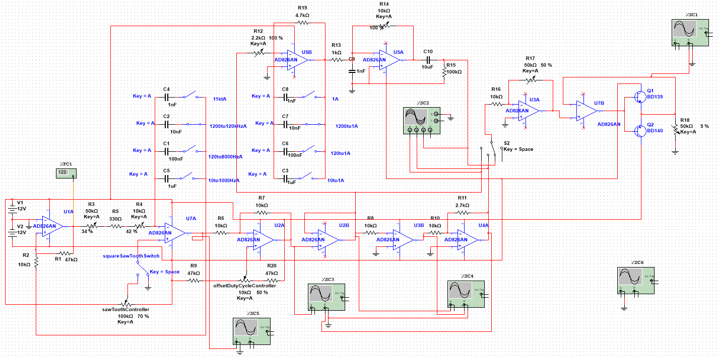
Circuit Diagram
Sine wave
Triangular and Saw-tooth
Square wave

Slide 3
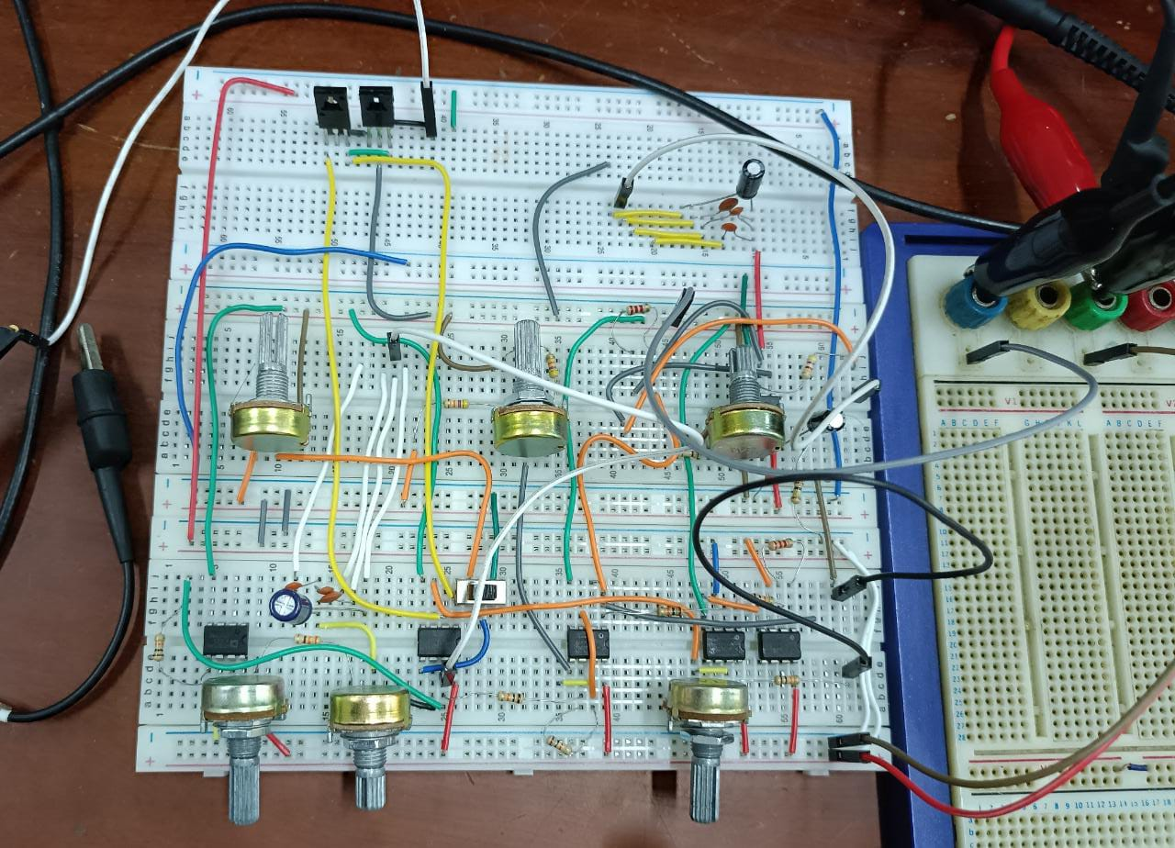
Circuit

Slide 4
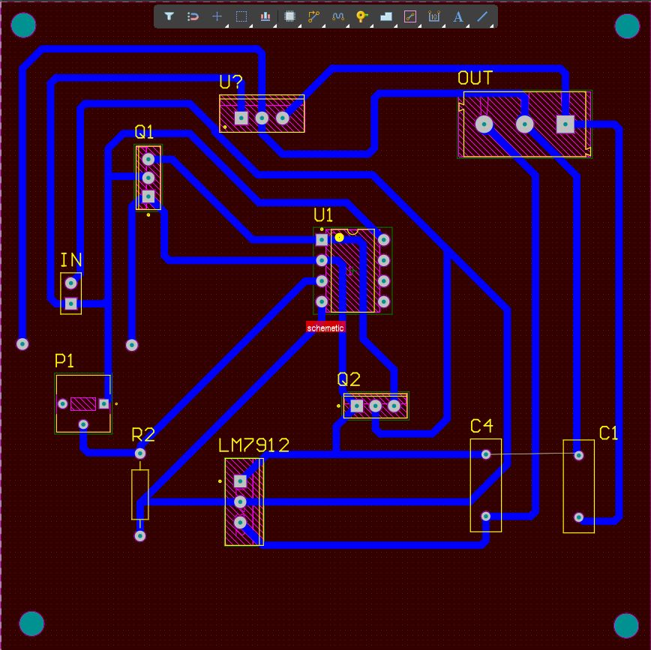
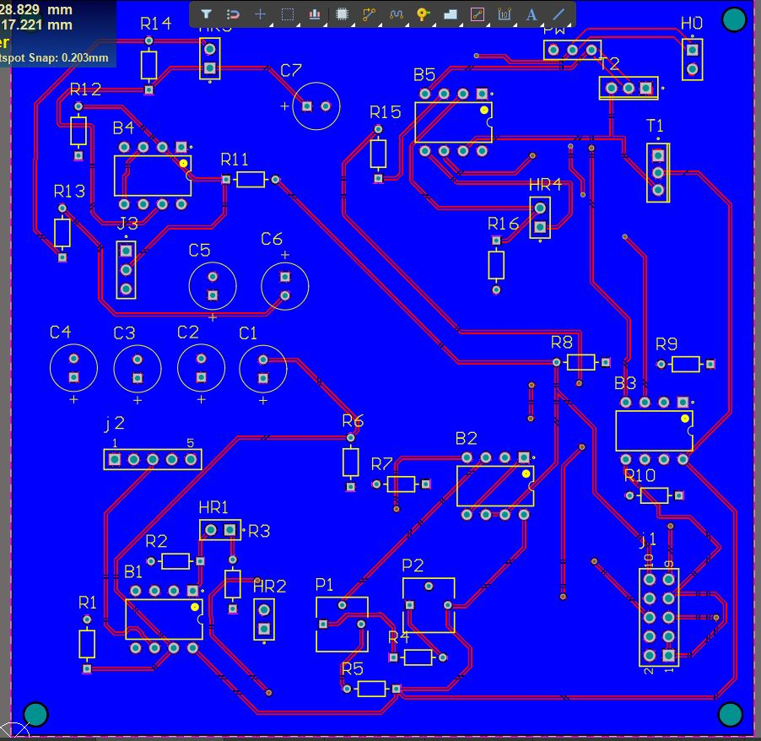
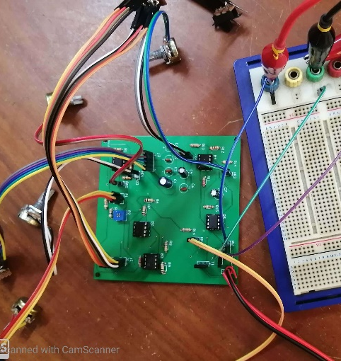
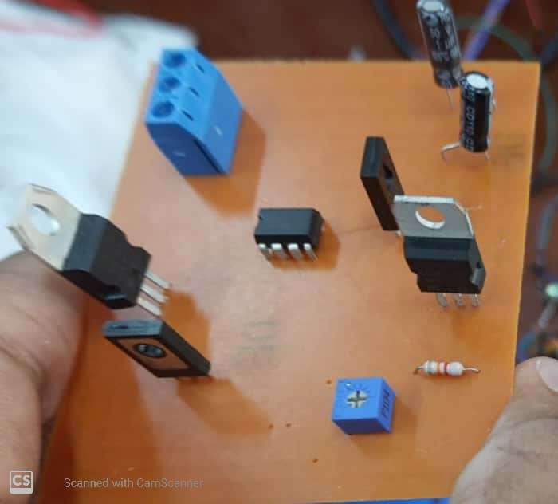
PCB Design
Main PCB
Power Supply Circuit

Slide 5
Block Diagram
Triangular and saw-tooth
Square wave
Saw-tooth / Triangle Selection
Frequency Selection
Duty Cycle Change
Schmitt Trigger
Integrator
Offset
Comparator
Attenuator
Triangular wave
Triangular Saw-tooth wave
Square wave
Sine wave
Frequency Selection
Integrator
Mode Selection
Amplifier
Push Pull
circuit
Amplifier
Sine wave

Slide 6
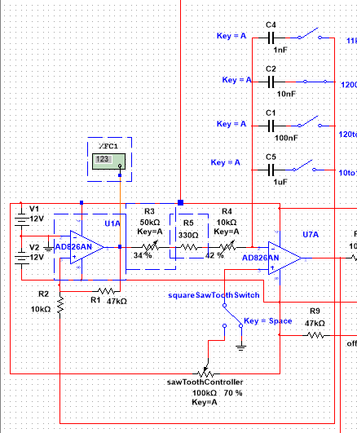
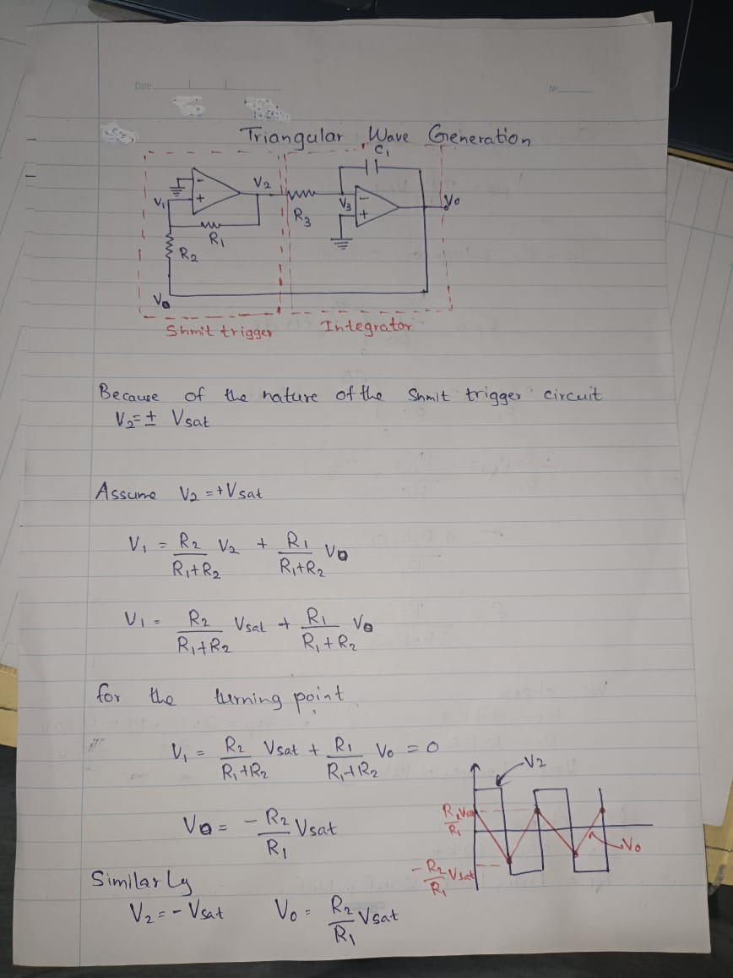
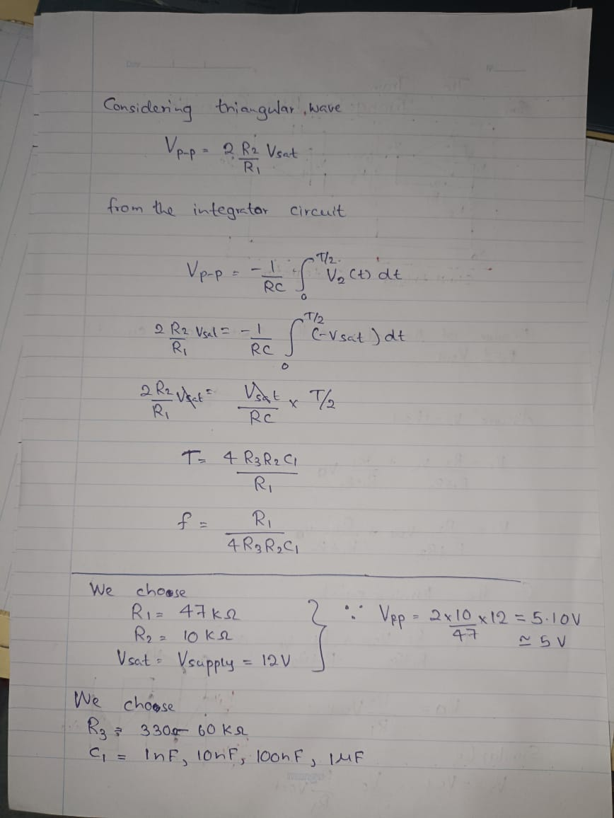
Triangular & saw tooth wave
Using Schmitt trigger circuit and integrator circuit, triangular wave and saw-tooth wave

Slide 7
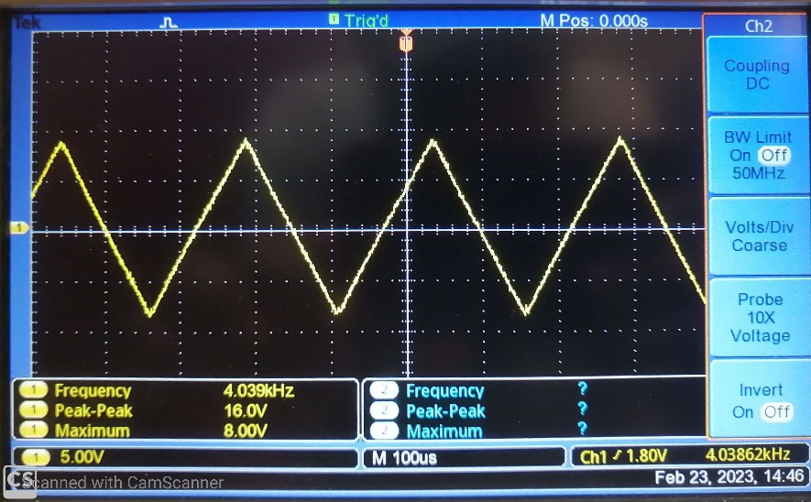
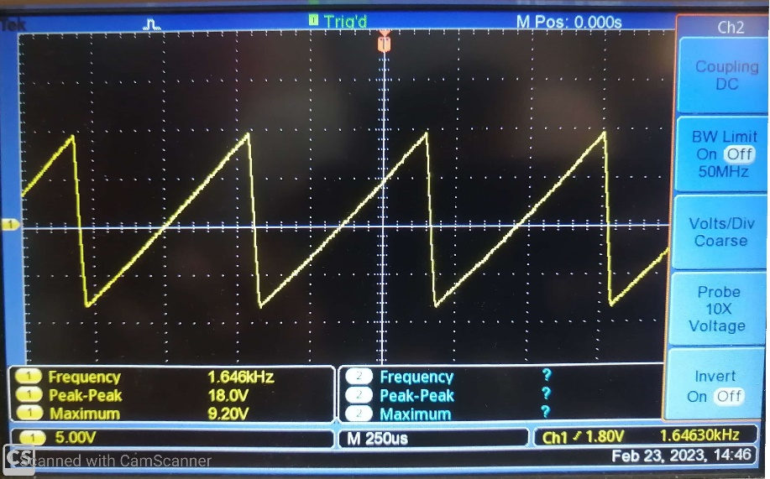
Triangular & saw tooth wave

Slide 8
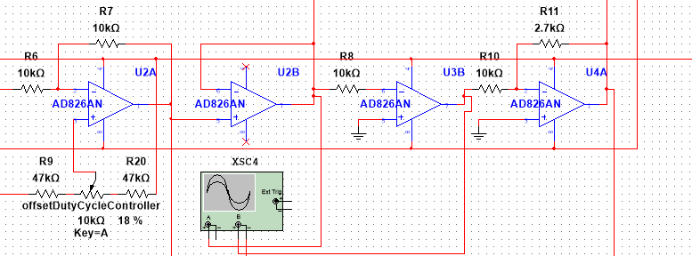
Square wave
Triangular Wave
Square Wave
Using a comparating with a triangular wave without an offset, we generate square wave with 50% duty cycle.
Using a comparating with a a triangular wave with an variable offset, we generate square wave with variable duty cycle.

Slide 9
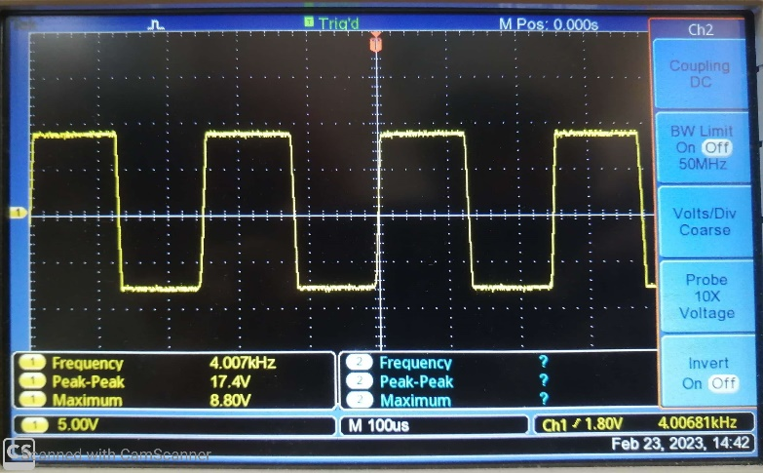
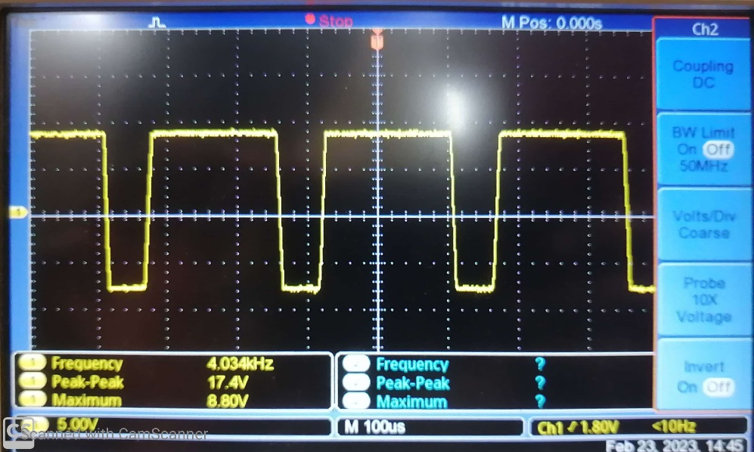
Square wave
Triangular Wave

Slide 10
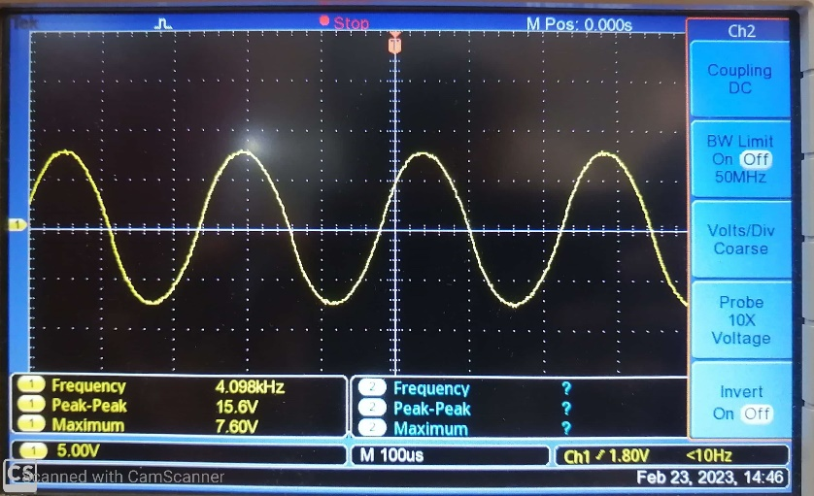
Sine wave
Triangula Wave

Slide 11
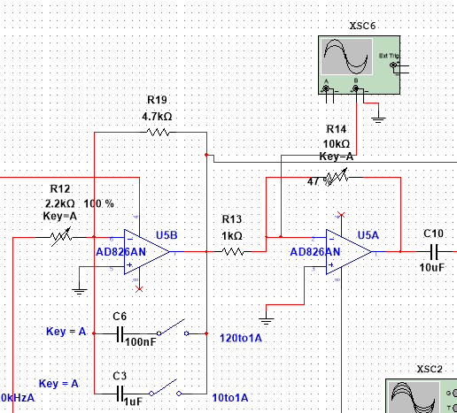
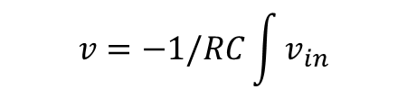
Sine wave
Sine Wave
$$v=−1/RC\int{v_{in}}$$
Triangular Wave
Integrating the triangular wave, we obtain approximation to the sine wave.

Slide 12
Component Selection
OpAmp | Slew rate v/µs (Data Sheet Value) | Practical v/µs (Data Sheet Value)
TL072 | 13 | 0.5
NE5535 | 9 | 3
AD826 | 300 | 20
Because we are using a comparator to make the square wave, there should be high slew rate values for a better function generation. Our calculated value of slew rate of the OpAmp is 300.

Slide 13
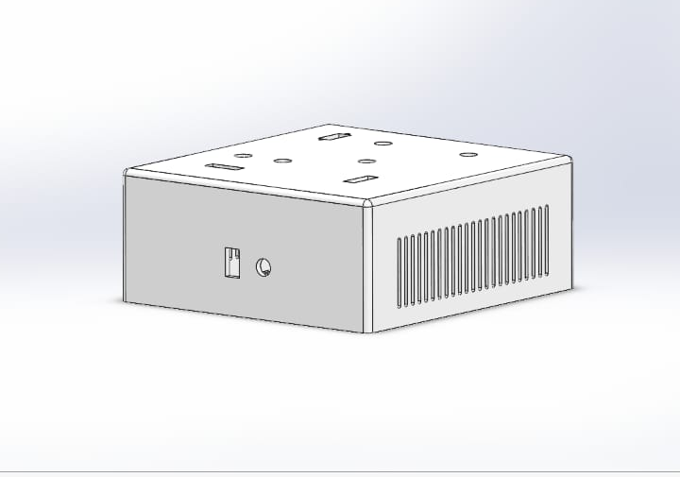
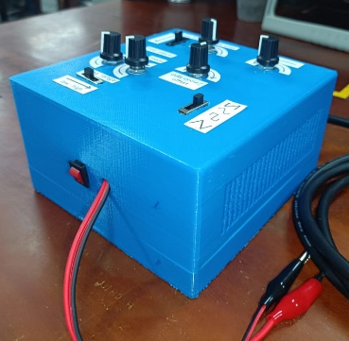
Enclosure Design

Slide 14
Thank you

